Slide 1

MEMBERSHIP UPDATES
Mult-District PETS Alliance | July 2025
Notes:
Hello, everyone. It’s a pleasure to be here with you today, and I want to start by thanking you for being such dedicated and passionate leaders in your areas and working so hard each year to ensure our club leaders – the most important people in Rotary – learn, grow, and feel prepared to lead.
It’s great to see so many old friends and familiar faces as well as some new ones. We’ve met in my various capacities here on staff at Rotary over the years since 2015 – from Club and District Support, to being the Regional Membership Officer for the Central US, to now managing our global team of RMOs situated around the world.
I can speak for the RMOs across North America when I say we greatly appreciate the opportunities you provide us to connect with so many club leaders at once at your events. I’m happy today to provide you with updates on membership initiatives and strategies that are most crucial for your club leaders.

Slide 2
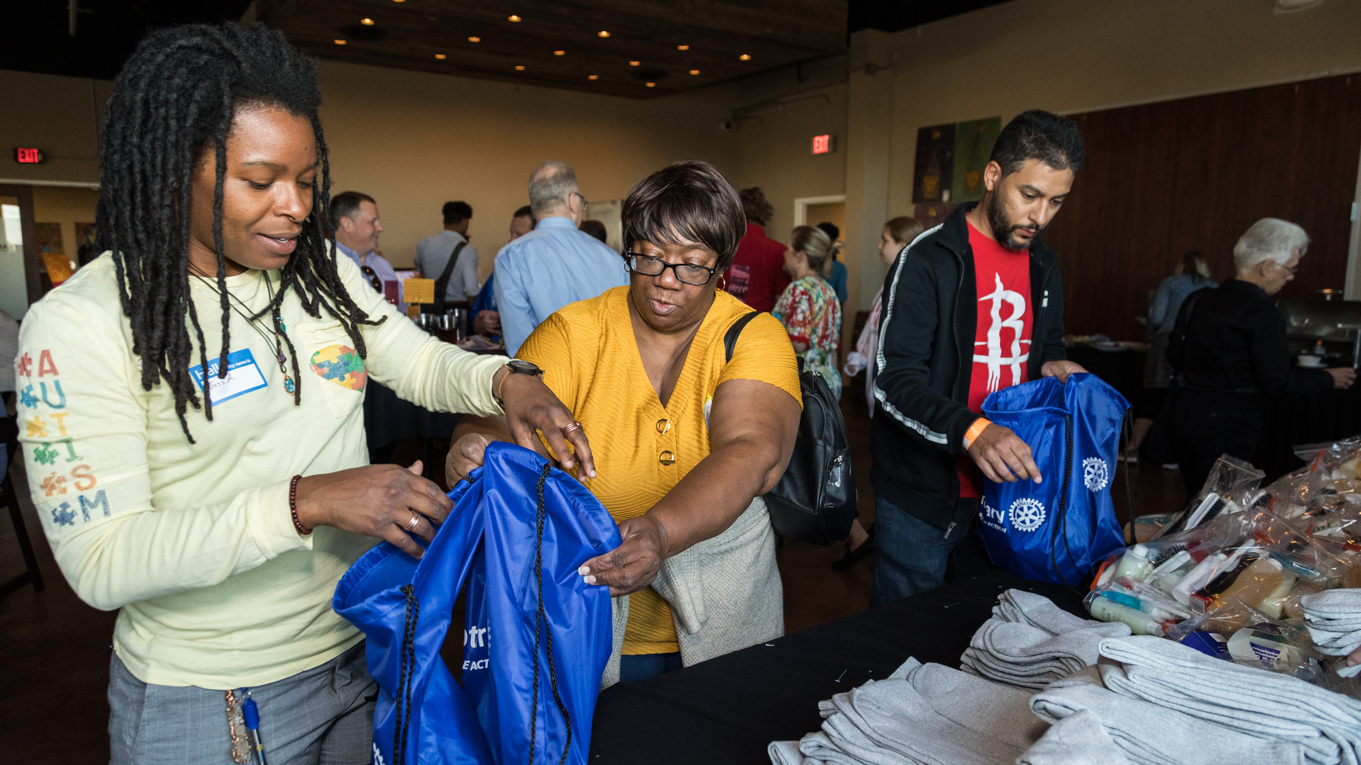
WHAT MATTERS MOST?
Club
experience
The single most important factor in our ability to satisfy and retain members
Notes:
Our team loves going to PETS because our clubs is where membership happens.
Each club is comprised of individuals who Unite for Good to make the Rotary world go round. It’s our members who generously give to our Foundation. It’s our members who use their diverse talents and life experiences to organize and carry out our service projects, to mentor people, to attract others to our organization through social events. It’s all of you – our members.
One thing I always ask presidents-elect is: “What matters most in Rotary?
What does research tell us is the single most important factor in our ability to satisfy and retain members?
What do you think many of them said? Service. Leadership. And sure, those are important – and they are all aspects of:
(Advance animation) The club experience.

Slide 3


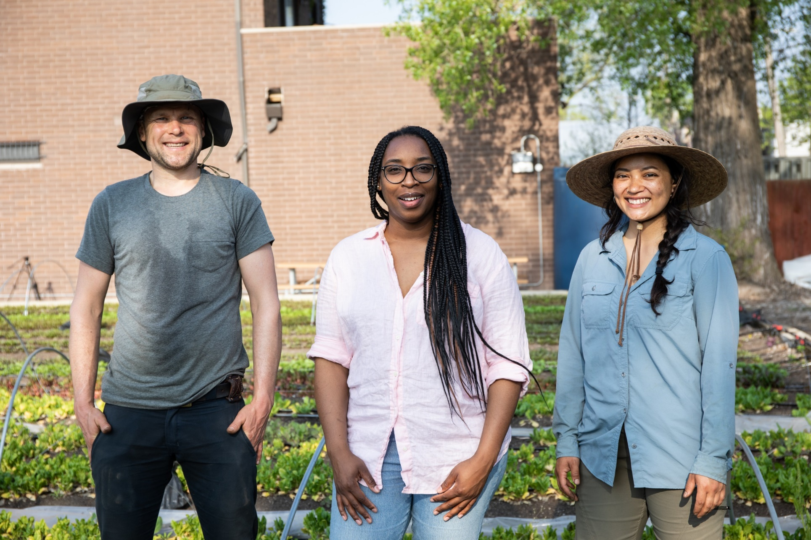


A MEMBER’s CLUB EXPERIENCE IS POSITIVE WHEN:
Members have confidence in club leaders and direction of the club
Members enjoy meetings/gatherings
Service opportunities make a difference
Members grow personally
Members develop meaningful friendships
Notes:
I hope you all know these aspects of what makes the club experience positive because Brianne shared them with you last year. They remain true! And it’s not rocket science.
Our research points to these elements as key contributors to a positive club experience:
Confidence in club leadership
Enjoyable meetings and gatherings
Impactful service opportunities
Personal growth opportunities
And the space to develop meaningful friendships
Notice it’s not just about service – it’s about leadership and personal development as well.

Slide 4
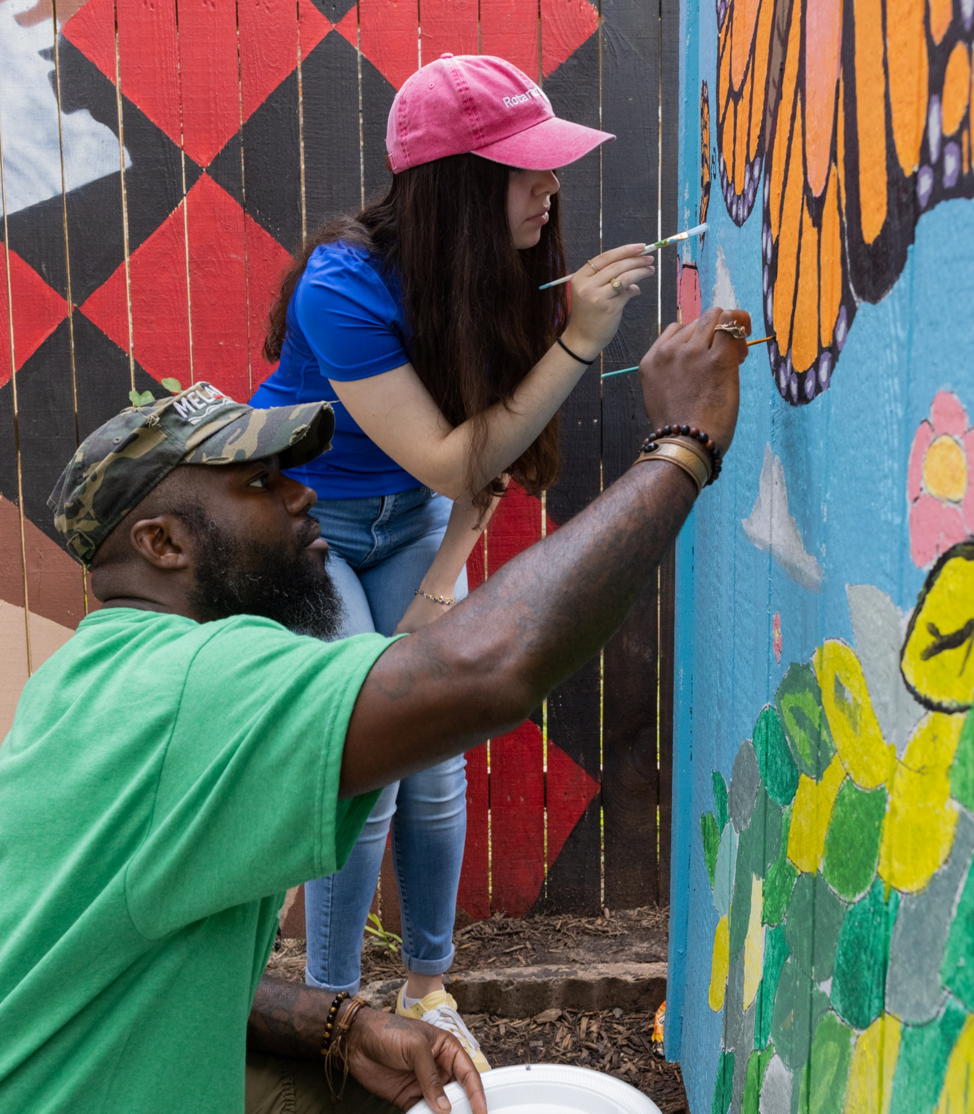
OPPORTUNITIES
Approximately 50% of all terminations are members for less than 3 years
Over 10% of new members leave within the same year of joining
20% of all districts have not chartered a new club in the last 5 years
Notes:
Why is it so important that we focus on supporting clubs in providing a positive experience?
Because we have tremendous opportunities here.
We know that about half of all member terminations happen within the first 3 years. In addition, over 10% of new members leave Rotary within the same year of joining. And our research tells us the top reasons people leave are because of the club environment and culture, unmet expectations, and time and financial obligations – all things that can be controlled by the clubs.
(Advance animation) Meanwhile, around 20% of all districts globally have not chartered a new club in the last 5 years.
So, what this is telling me, is that our current experiences are not giving people what they want and need in order to stay – and we don’t have enough new clubs to entice them.

Slide 5
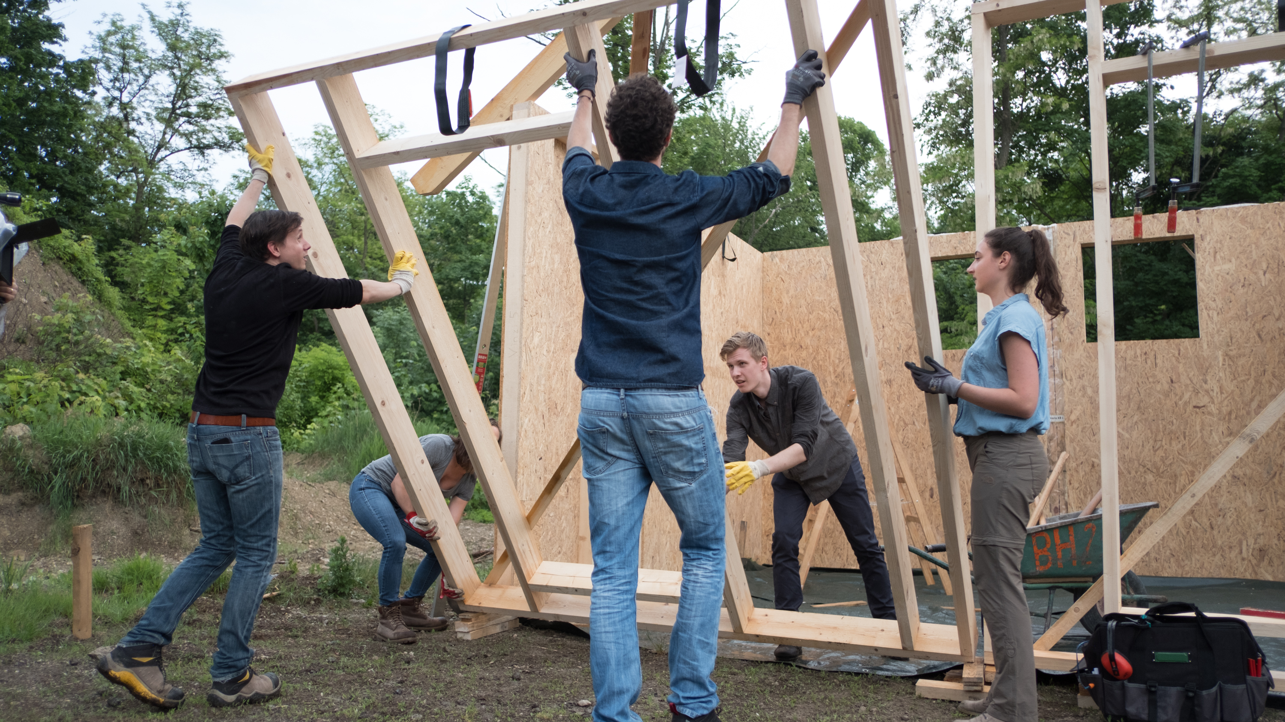
CLUB FLEXIBILITY & DEVELOPMENT
Notes:
If our current clubs aren’t meeting the needs of new and prospective members and enticing them to stay, then there is also a need for new and innovative clubs to form while working with existing clubs on the experience they offer.
Let me be clear, I am not suggesting we push incoming club leaders to try to start new clubs. Imagine how overwhelming that would feel for them! They’re focused on their club, as they should be. But, there are aspects of club development that can help them revitalize their club and meet current and prospective members needs that maybe their current club cannot.
Case in point, our various club models that current clubs could adopt to be more focused in a particular way.

Slide 6
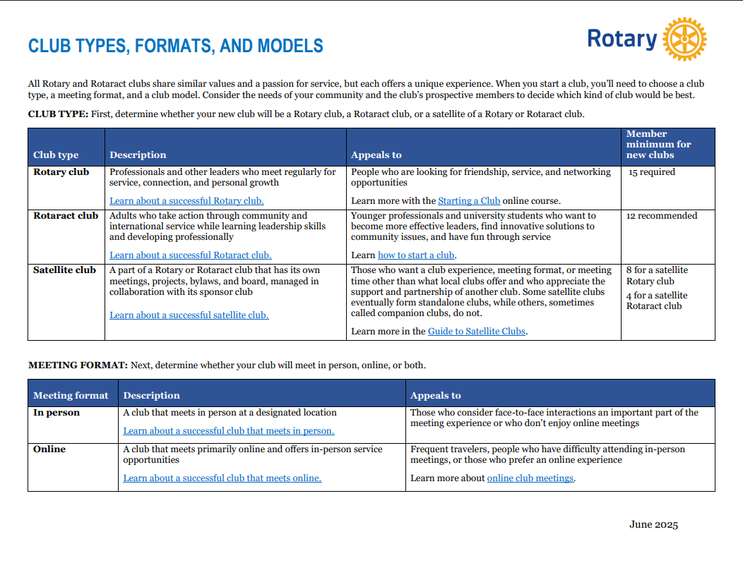

Slide 7
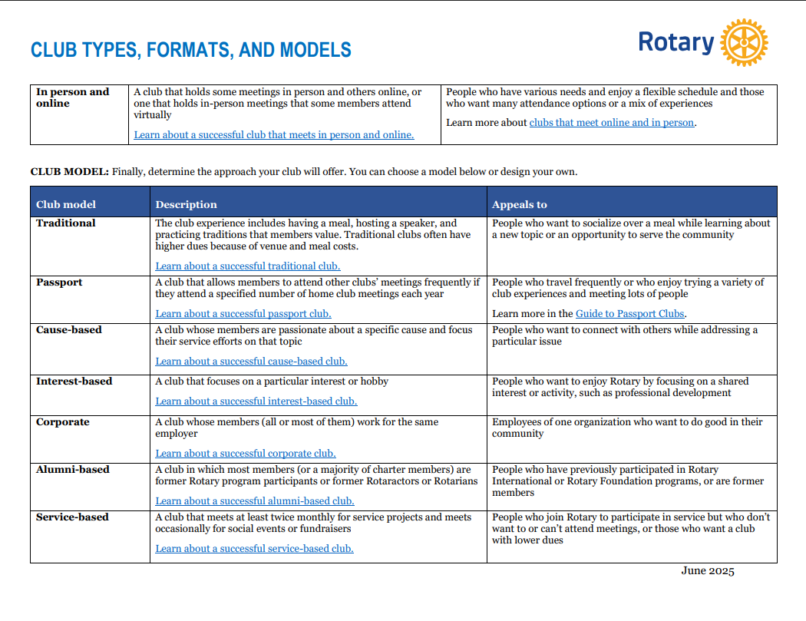

Slide 8
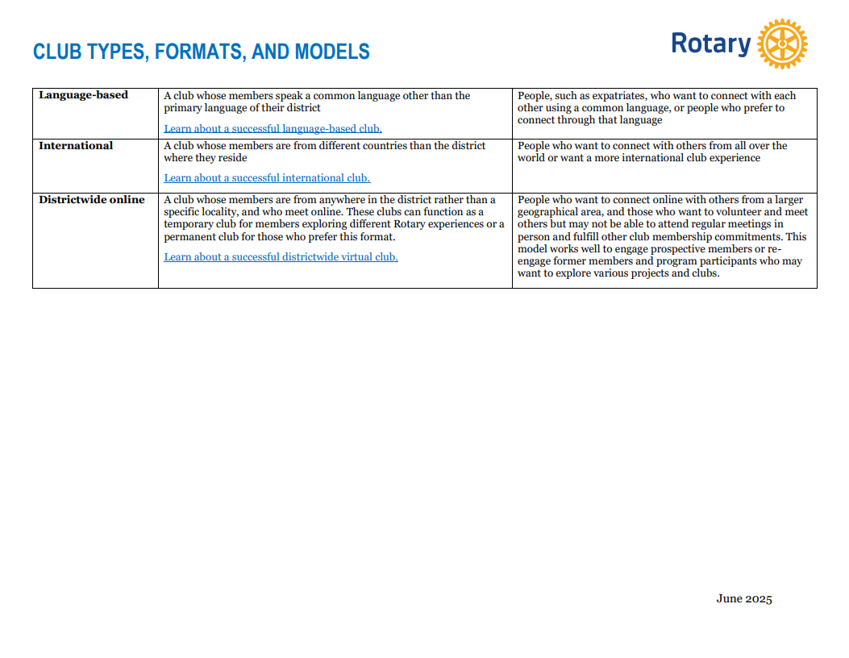

Rotary.org/Membership → Start a new club

Slide 9
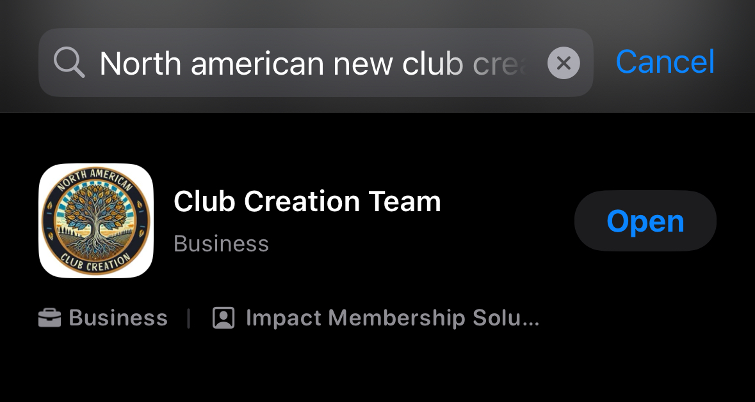
North American New Club Creation Team & App
Notes:
Speaking of satellite clubs – even though they have been around for over a decade, we find there is still sometimes confusion and fear about forming them. We recently created this video that helps explain what they are and how they can benefit clubs.
You’ll hear more about companion clubs or impact clubs – technically those are satellite clubs,
[Play satellite club video]

Slide 10
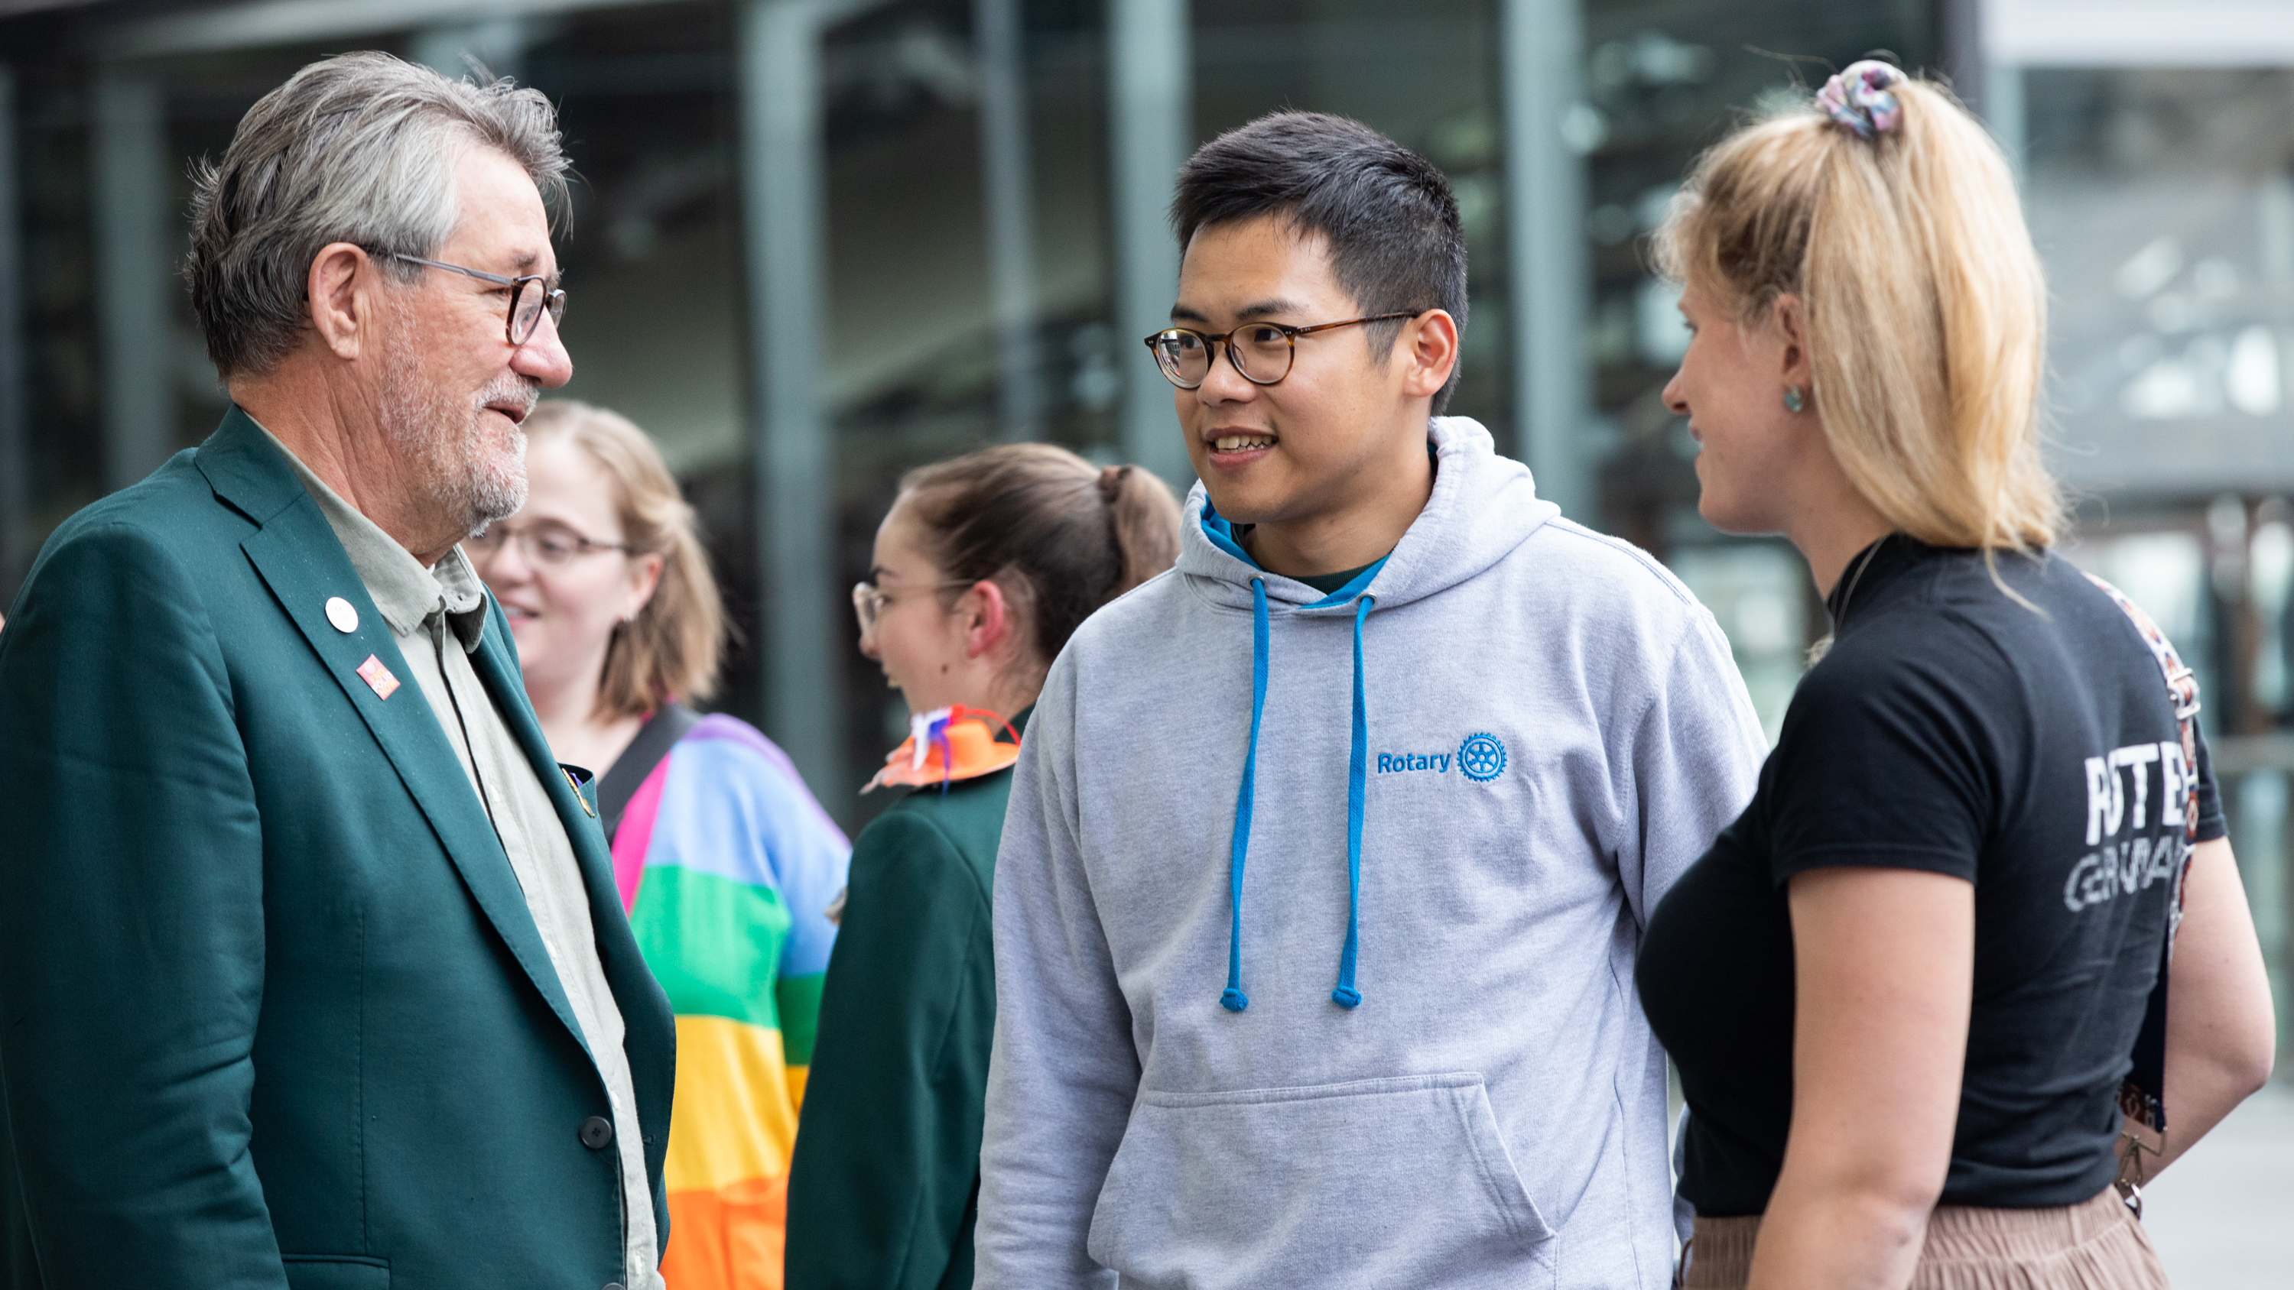
CONNECTING WITH PROSPECTIVE AND NEW members
Notes:
First and foremost, being prospective member-centered is the most important thing.
Considering who is missing from the table in our clubs and then forming genuine relationships with them – that aren’t just focused on US AND OUR STORY – is crucial.
Our team has found this skill of putting ourselves in someone else’s shoes does not come as naturally to our members as one would think. So we’ll work on that in club experience breakouts later.

Slide 11
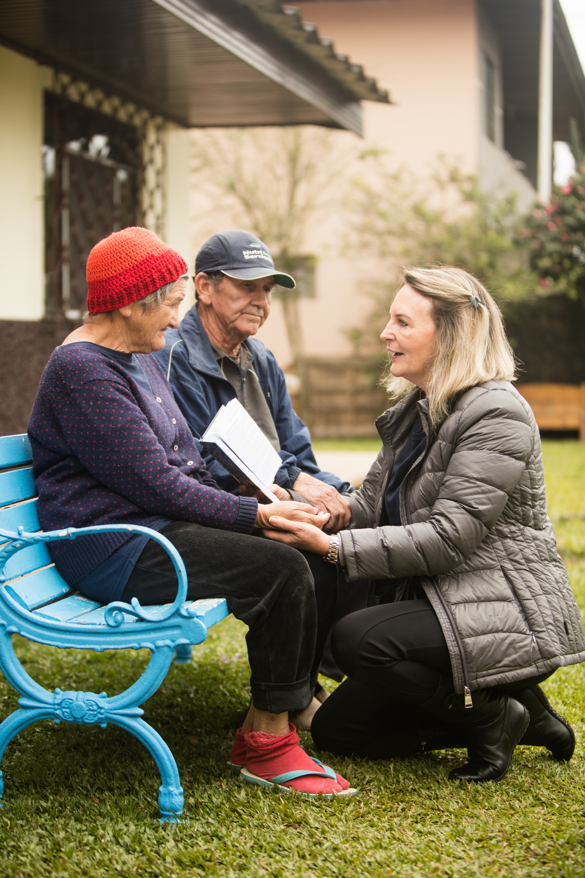
Comfort and care
Community
Home
Notes:
Do we feel cared for and comforted or like we’re home when someone just talks about themselves and tells us their story?
No, that feels one-sided.
Do we feel cared for and comforted when someone makes assumptions about us based on what we look like? Our age? Our gender? No, that feels alienating.
Please – encourage our club leaders to practice being curious about others. To asking them questions in order to get to know their interests, skills, background, and ideas. I can tell you I experienced in my own club, them not doing this. All they focused on was that I was staff. Some thought that was an advantage to them and some thought that I was big brother. None of them asked me about my family, about my interests, ABOUT ME beyond work. And this is what we would consider in Rotary, a vibrant club, on paper. I’m telling you – if we can reshape how clubs approach people, we can better retain our members. And judging by those stats I shared earlier, I think we have a lot of work to do in that area. We bring people in, and they leave. And it’s because of the club experience not being up to snuff.

Slide 12

WHY?
Best-in-class technology partner (Salesforce)
Allows prospective member to choose the club best suited to their needs
Lead notifications go directly to clubs, with automated reminders and escalation to district if necessary
~30,000+ leads per year
  61% under 40 & 35% female
66% followed up by district
100,000 candidates stuck at district level
Feedback from district and club leaders globally
MEMBERSHIP LEADS REDESIGN
What is changing? Why?
Notes:
As we think about planning for the year ahead, we want to take some time to highlight changes happening with Rotary’s membership leads system.
Ask who is aware of membership leads
In the current process, prospective members who reach out through rotary.org/join are assigned by RI staff to district leaders and districts then assign prospective members to a Rotary club.
In the new system, we are flipping the process. By partnering with Salesforce, a best-in-class technology solution, the new Membership Leads Management System will:
Provide prospective members information when they first express interest in Rotary that empowers them to make a club selection, directly. They will be able to review different clubs and choose one they think will best suit their schedule, needs and interests.
And to make sure that all new inquiries are followed up on quickly, the system will use marketing automation over a specified period. These automated emails will remind club officers to contact the lead and update their status. If no action is taken by a club within a set time frame, that inquiry will be automatically escalated to a district. And if the district takes no action, the inquiry will be escalated to Rotary International for intervention. This process ensures that no prospective member waits more than three weeks to hear back from Rotary.

Slide 13
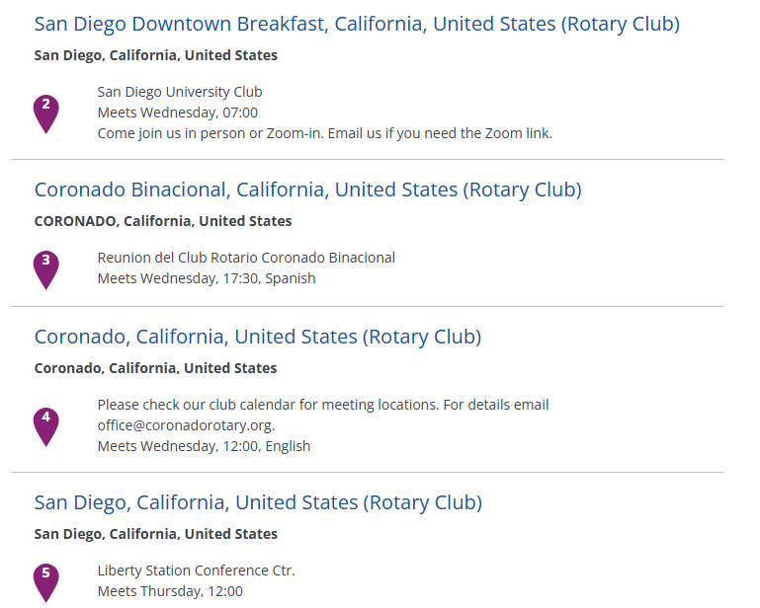
Supporting clubs through change
Ensure club officers are reported to Rotary and have My Rotary Accounts
Confirm club details as shown in Club Finder on Rotary.org
Notes:
Be sure that you and all your club officers have a My Rotary account. As with the current process, access to membership leads starts by signing in to My Rotary.
Check that club leaders are listed in my Rotary. Automatic email alerts will be sent to the club president, club membership chair, and club secretary as listed in My Rotary, so now is a great time to make sure all roles are up-to-date and added in My Rotary.
Ensure that your club’s information, including your website, meeting details, and location, is correct in My Rotary. This will make you more visible to prospective members who visit rotary.org/join, and help them make the most informed decision on what club is the best match for them. Also ensure your club website and any social media accounts are up-to-date and showcase your club activities.

Slide 14


NEW MEMBER ENGAGEMENT CAMPAIGN
Notes:
In addition to those resources that are available, I want you CPEs to be aware of some opportunities for some direct engagement.
Meanwhile, to complement the work that our clubs and districts are doing, all new members will soon be receiving a series of messages directly from Rotary International over the course of their first year of membership. This is intended to help introduce them to the broad menu of opportunities to get involved and derive value out of their membership – particularly beyond their own club.

Slide 15
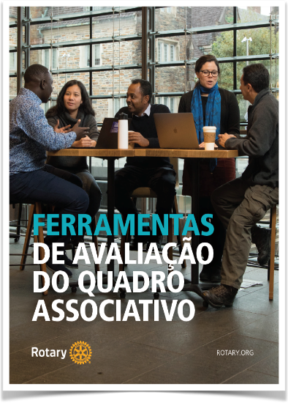
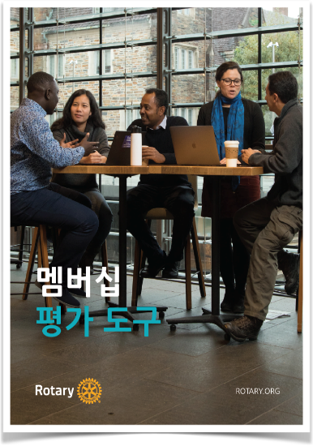
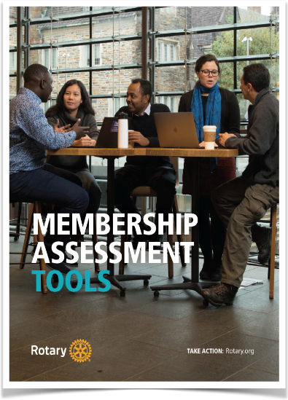
RESOURCES | Rotary.org/membership
Notes:
Resources – Membership Assessment Tools
Rotary.org/Membership

Slide 16
THANK YOU!
Emily.Tucker@rotary.org MembershipDevelopment@rotary.org

